Slide 1
E&M and Relativity
Eric Prebys, FNAL

Slide 2
Maxwell’s Equations
In terms of total charge and current
In terms of free charge an current
Local effects of media

Slide 3
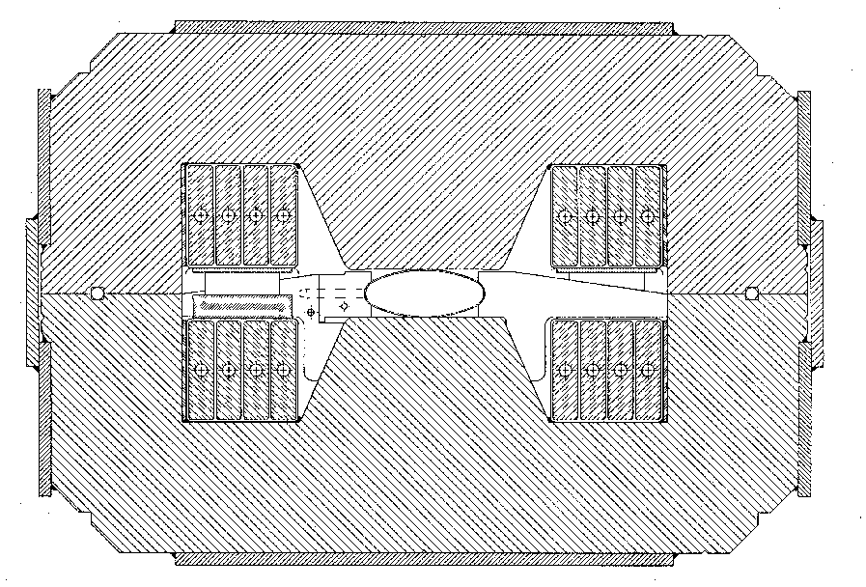
Example: Field in a permeable dipole
Cross section of dipole magnet
Integration loop
g

Slide 4
Electrodynamics and Electrodynamic Potentials
We can write the electric and magnetic fields in terms of Vector and Scalar potentials
Particle dynamics are governed by the Lorentz force law

Slide 5
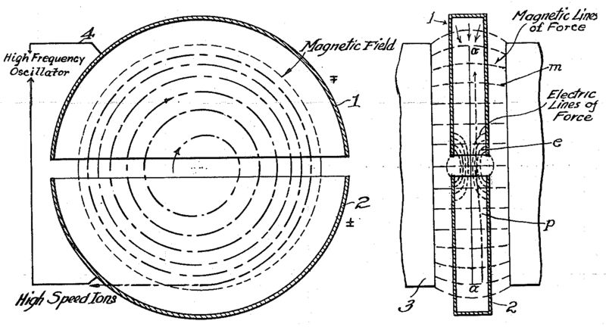
Cyclotron (1930’s)
side view
top view
A charged particle in a uniform magnetic field will follow a circular path of radius
“Cyclotron Frequency”
Red box = remember!
For a proton:
Accelerating “DEES”

Slide 6
Relativity
Some Handy Relationships (homework)
Basics
A word about units
For the most part, we will use SI units, except
Energy: eV (keV, MeV, etc) [1 eV = 1.6x10⁻¹⁹ J]
Mass: eV/c² [proton = 1.67x10⁻²⁷ kg = 938 MeV/c²]
Momentum: eV/c [proton @ β=.9 = 1.94 GeV/c]

Slide 7
4-Vectors and Lorentz Transformations
We’ll use the conventions
Note that for a system of particles
We’ll worry about field transformations later, as needed

Slide 8
Some Handy Relationships
Know all of these by heart because you’re going to use them over and over!

Slide 9
Synchrotrons and beam “rigidity”
The relativistic form of Newton’s Laws for a particle in a magnetic field is:
A particle in a uniform magnetic field will move in a circle of radius
In a “synchrotron”, the magnetic fields are varied as the beam accelerates such that at all points , and beam motion can be analyzed in a momentum independent way.
It is usual to talk about he beam “rigidity” in T-m
Booster: (Bρ)~30 Tm
LHC : (Bρ)~23000 Tm

Slide 10
Thin lens approximation and magnetic “kick”
If the path length through a transverse magnetic field is short compared to the bend radius of the particle, then we can think of the particle receiving a transverse “kick” and it will be bent through small angle
In this “thin lens approximation”, a dipole is the equivalent of a prism in classical optics.

Slide 11
Field multipole expansion
Formally, in a current free region
The general solution in two dimensions
Magnetic field is the gradient of a scalar…
…which satisfies Laplace’s equation

Slide 12
Solving for B components
Combining

Slide 13
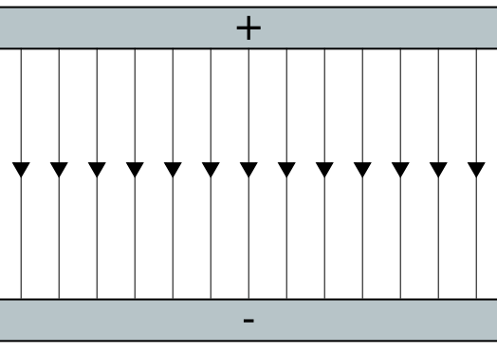
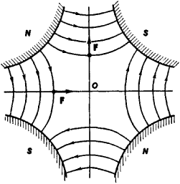
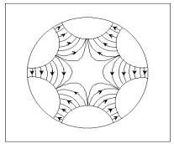
Symmetry properties of mulitpoles
The phase angle δ_{m} represents a rotation of each component about the axis. Set all δ_{m} =0 for the moment

Slide 14
Back to Cartesian Coordinates. Differentiate both sides n times wrt x
And we can rewrite this as
“Normal” terms always have B_{x}=0 on x axis.
“Skew” terms always have B_{y}=0 on x axis.
Generally define
“normal”
“skew”

Slide 15
Expand first few terms…
Note: in the absence of skew terms, on the x axis
dipole
quadrupole
sextupole
dipole
quadrupole
sextupole
octupole

Slide 16
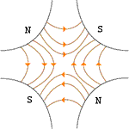
Application of Multipoles
Dipoles: bend
Quadrupoles: focus or defocus
A positive particle coming out of the page off center in the horizontal plane will experience a restoring kick

Slide 17
Sextupoles Octupoles
Sextupole magnets have a field (on the principle axis) given by
One common application of this is to provide an effective position-dependent gradient.
In a similar way, octupoles have a field given by
So high amplitude particles will see a different average gradiant

